Slide 1

Leadership for
Millennials Generation
Pambudi Sunarsihanto, MSc, MBA

Slide 2
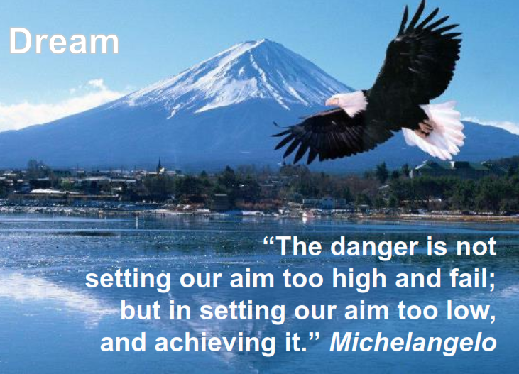

Slide 3
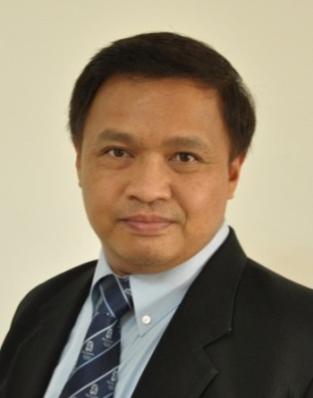
Pambudi Sunarsihanto, MSc, MBA
2016 - … : HR Director, Danone Aqua, Indonesia
2013 – 2016 : HR Director, Citibank Indonesia, Jakarta
2011-2013: People Development Consultant, MAZARS, Singapore
2010-2011: Head of Competence Development, Nokia Siemens Networks, Munich
2008-2010: Executive Vice President, Human Resources, Telkomsel, Indonesia
2006-2008: Head of HR Development, Nokia Mobile Phones, China
2000-2006: Head of Training & Development, Nokia Mobile Phones, Singapore
Education:
MBA Helsinki School of Economics, Finland
Master in Computer Science at University of Nantes, France
Bachelor in Computer Science at University of Nantes, France
Working Languages : English, French, Bahasa Indonesia

Slide 4

The world has changed
The world is changing
The world will
continue to change
…

Slide 5


We live now in a VUCA world
Uncertainty
Ambiguity
Complexity
Volatility

Slide 6
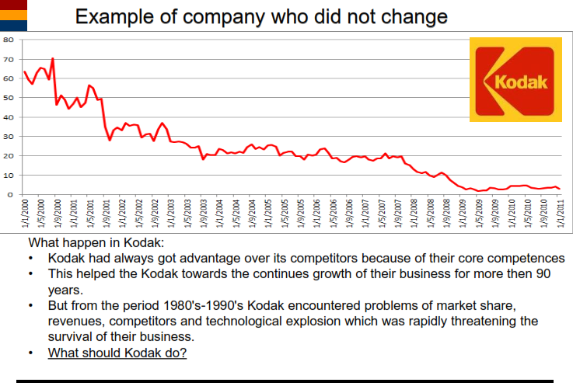

Slide 7
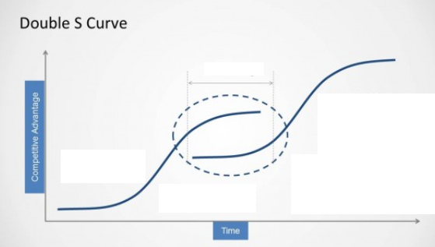
Innovations

Slide 8
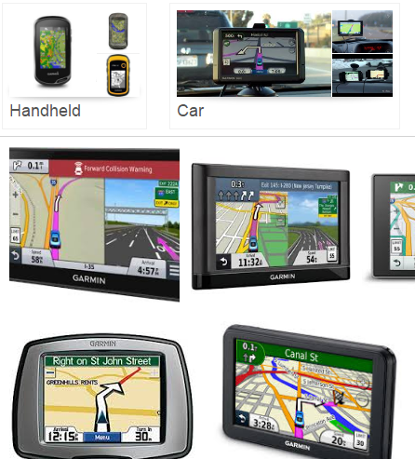
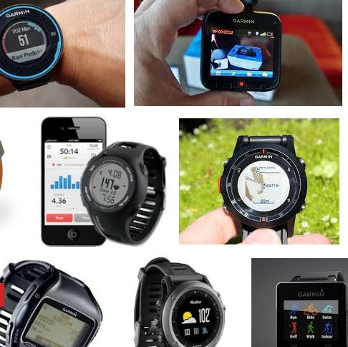

Garmin

Slide 9
Are You a Garmin
Or a Kodak?

Slide 10
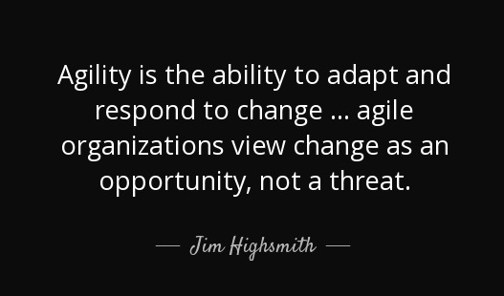

Slide 11

Lead Your Business
Lead Your Team
Lead Yourself

Slide 12
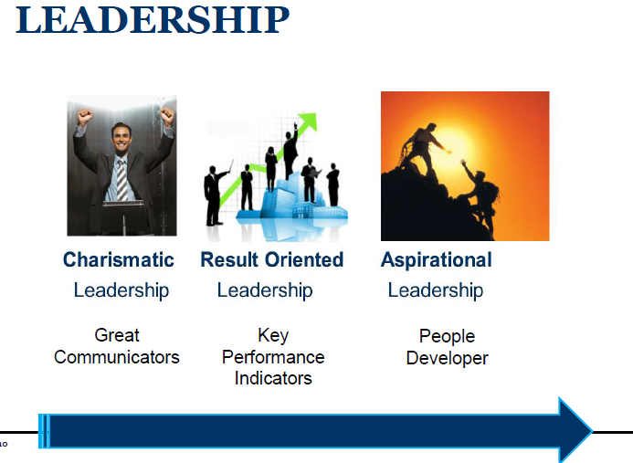

Slide 13
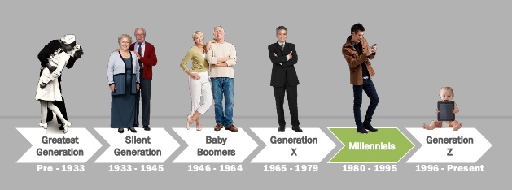
Millenial Generations

Slide 14



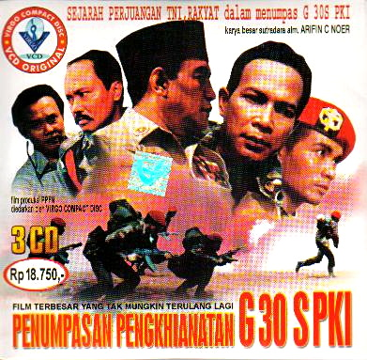
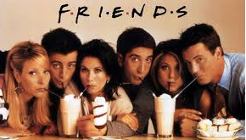
Instant generation

Slide 15
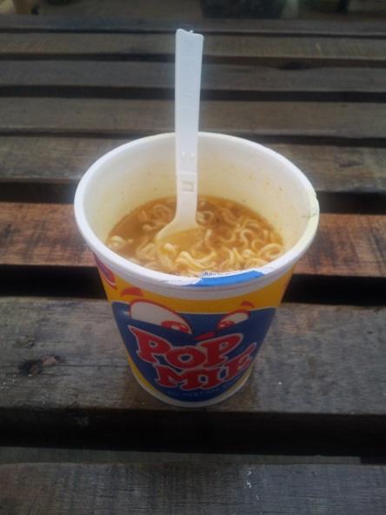
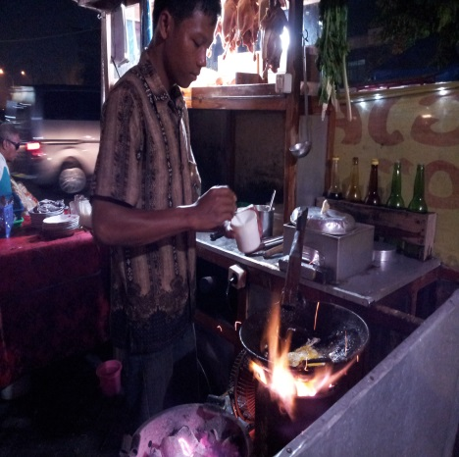
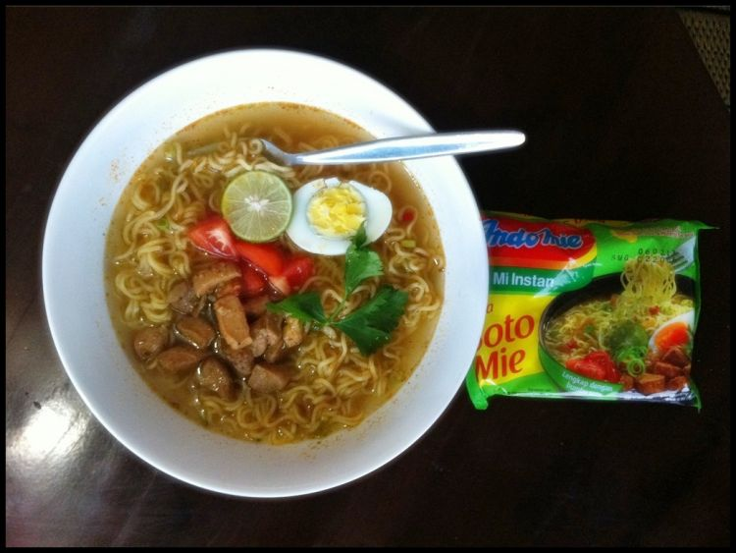
Instant generation

Slide 16
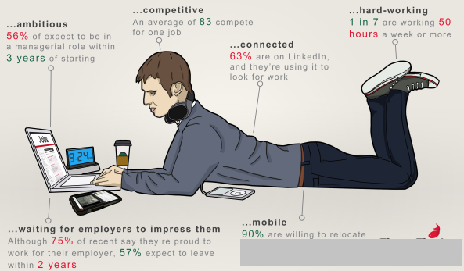

Who are they?

Slide 17
Trend with Millennial Generation
Connected (Tech-Savvy, expert in digital world)
Multi-taskers (not depth)
Freedom & Creativity => Entrepreneur
Faster career path
Demanding
They work “with” the company (not for the company)
=> Opportunities

Slide 18
Challenges with Millennial Generation
Communication (content and context)
Nature of the work (project, creative)
Teamwork
High Turn-Over Rate
Team Performance

Slide 19
What we should do …
Leadership (leader’s role in developing/motivating people)
Faster career path (the time they spend in one role)
Reduce working hours, do things differently
Exposure to senior management
Go Digital
Go Global (International assignment)
“Reverse-mentoring”

Slide 20

Conclusion: Leading Millenials Generation
Vision
Opportunity
I ncentive
Community
E ntrepreneurship

Slide 21
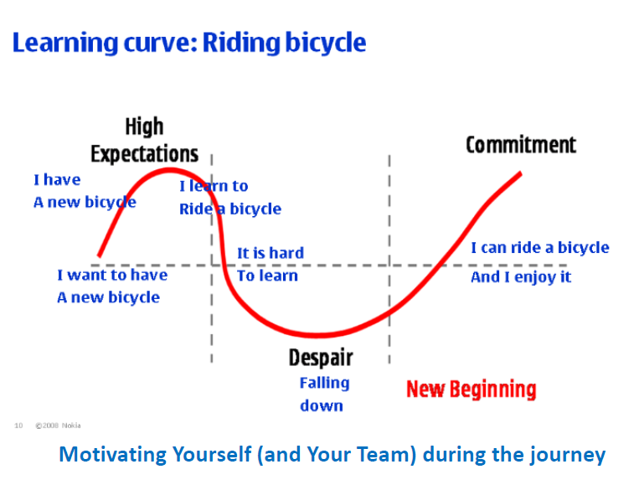

Slide 22
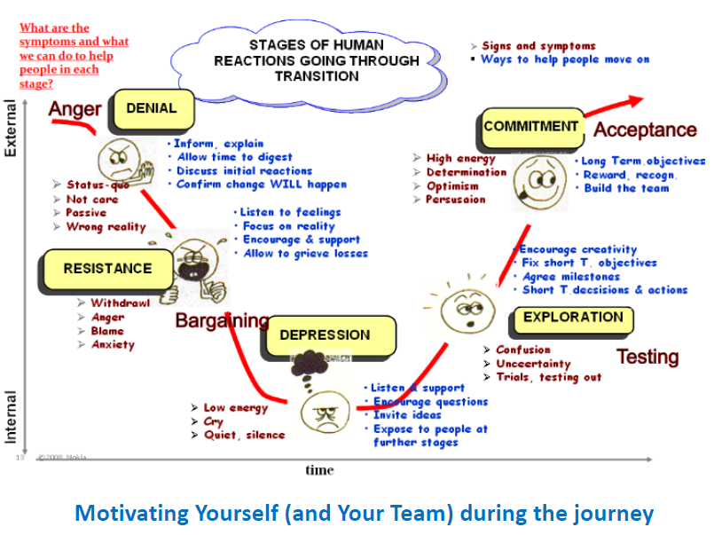

Slide 23
Different leadership style in
Different time
The Energizer
Maturity
Decline
The Entrepreneur
Rebirth
The Controller
Rapid-Growth
The Executor
Start-Up
The Entrepreneur
Lifecycle of a business

Slide 24
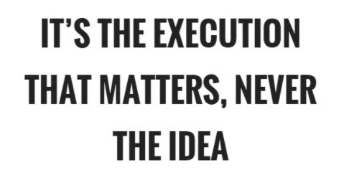

Slide 25


